Slide 1
Statistics
Origin and Development of Statistics:
It is not a new discipline-it is old as the human society itself.
In ancient times, the scope of statistics was primarily limited to the collection of the following data by the government for framing military and fiscal policies:
i) age and sex-wise population of the country
ii) property and wealth of the country
The former enabling the government to have an idea of the manpower of the country and the latter provide the information for the introduction of new taxes and levies.
The earliest census of population and wealth was conducted by the Emperors of Egypt in connection with the construction of famous “Pyramids”. Such census were later held in England, Germany and other western countries.
In India, official and administrative statistics existed even 2000 years ago-in particular during the reign of Chandragupta Maurya (324-300 BC).
Collection of Vital statistics and registration of births and deaths were made even before 300 B.C. as mentioned in Kautilya’s Arthashastra.

Slide 2
Statistical System in Nepal – A Review
• Prior to 1950 – official statistics in terms of population statistics was used to be released by the office namely “Janasangkhya Goshwara”(Population Statistics Office) and “Audhyogik Byaparik Samachar Sangraha Addaa” (Industrial and trade information compilation Office)
• Establishment of “Sangkhya Bibhag” (Department of Statistics) 1949 that conducted Population Census 1952/54
• Adoption of Statistical Act 1958
• Based on Statistical Act, Established CBS (central bureau of statistics ) in January 1, 1959 (Poush 17, 2015)
• According to the provision of the Statistical Act, CBS is the sole authorized agency responsible to collect, process, analyze and disseminate data.
Major Stakeholders in Statistical System
• Key Data Producers
– CBS
- Other Government Organizations (Ministries, Departments) –
- Nepal Rastra Bank (Central Bank)
- Non‐governmental Organizations
– Private Agencies (FNCCI, TPC)
• Funding/Supporting Agencies (ADB, WB, UNDP, UNFPA/UNICEF, IMF, DFID, JICA…)
• Universities
• Academicians
• Data Users

Slide 3
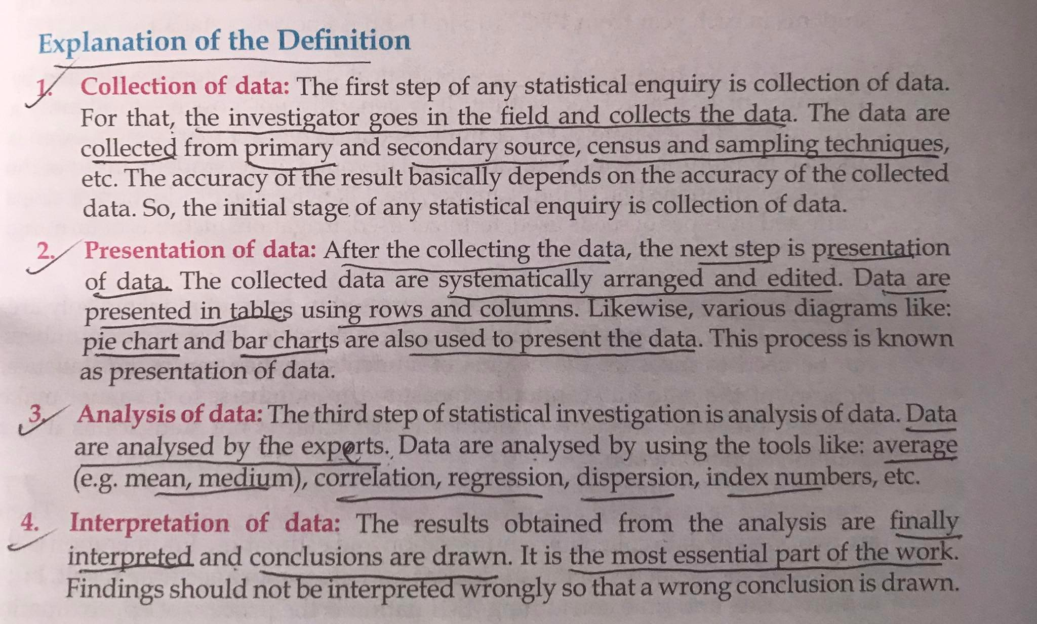
Definition of statistics
Different writer have defined statistics in different way and these can be broadly categories into two groups:
Singular definition of statistics:
In singular sense, statistics means “ the science of collection, presentation, analysis and interpretation of numerical data”.

Slide 4
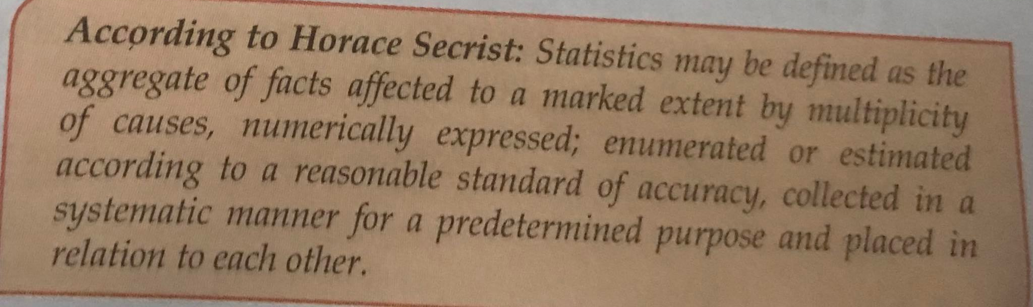
b) Plural definition of statistics:
In Plural sense, statistics is defined as “ the numerical set of data collected systematically for a predetermined purpose.”
Explanation of the definition:
1) Aggregate of facts: according to Secrist, statistics is aggregate of facts. A single unit of the study cannot be considered as statistics. It should be in aggregate manner. For instance, the height of an individual or the price of particular commodity do not form statistics as such figures are uncomparable. However, aggregate of figures of births, deaths, sales, profit etc over different periods will constitute statistics.

Slide 5
2) Affected by multiplicity of causes: statistical data are generally affected by a number of factors related with it. For example, measure the production of crops is affected by seeds used, fertilizer, irrigation, methods of farming etc.
3) Numerically Expressed: only the numerical data constitute statistics. For example, the statements like “ the production of crop is increasing” does not constitute statistics. But if we say, “the production of crop is increased by 20%” it is termed as statistics. Hence, the qualitative characteristics like honesty, beauty etc which can not be measured quantitatively does not constitute statistics.

Slide 6
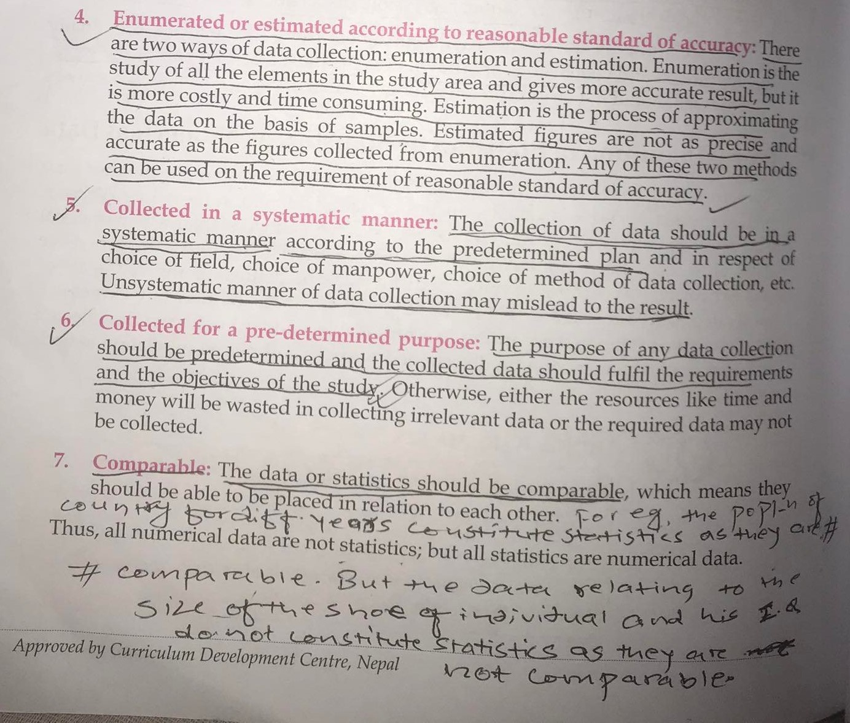

Slide 7
Scope and importance of statistics
In ancient times, statistics was regarded only as the science of state affairs and was used to collect information relating to crimes, military strength, population, wealth etc.
But due to the development of statistical techniques during the last few decades, it is viewed not only as a mere device for collecting numerical data but as a means of sound techniques for their analysis and drawing valid conclusions from them.
Now, it has numerous applications in various diversified fields such as economics, accounting, planning, auditing, business, sociology etc.

Slide 8
Contd….
Importance of statistics in different disciplines can be explained as below:
Statistics in Economics: Statistical data and advanced techniques of statistical analysis are immensely useful in the solution of a variety of economic problems such as consumption, production, distribution of income, prices, investment, saving etc. For example, consumption statistics helps to know the purchasing capacity and standard of living of different sections of the society. Similarly, Income and wealth statistics helps to reduce the disparities of income. Besides it, statistics related to macro economic variables like production, income, expenditure, saving, investment etc are used for the compilation of National Accounts.
Time series analysis, forecasting, index numbers, regression analysis etc are important statistical techniques to analyze economic data.

Slide 9
b) Statistics in business and management: various statistical tools and techniques are used by large business corporation in making Marketing Decisions, Inventory control, Accounting, Sales control, Quality control and so on.
c) Statistics in Planning: statistics is indispensable in planning- may it be in business, economics or government level. In order to achieve pre-determined goals and for efficient planning, statistical tools are required. For instance, the government must have an idea of the age and sex-wise break up of the population projections of the country in order to capitalize demographic dividend. This can be achieved only from the powerful statistical tool of forecasting.
d) Statistics in mathematics: Statistics is a branch of applied mathematics. In order to formulate various mathematical models, statistics plays a crucial role.

Slide 10
e) Statistics in social science: every social phenomenon is affected by factors which brings variation in observations. Statistical tools like regression and correlation analysis are used to study and isolate the effect of these factors on the given observation. The most important application of statistics in sociology is in the field of Demographic projections like birth rate, death rate, population growth etc.
f) Statistics in psychology and Education: Statistics is widely used in the scaling of mental tests and other psychological data, for determining the Intelligence Quotient (I.Q) etc.
Besides it, in the field of medical science and biology, astronomy, insurance etc there is the immense use of statistics.

Slide 11
Limitation/weakness of Statistics
Although statistics is indispensable in various fields, it has some limitations:
It does not study about qualitative phenomenon: statistics only deal with the quantitative variables but it can not be used to study qualitative characteristics like honesty, welfare, beauty etc.
It does not deal with individual: By statistics we mean aggregate of facts. It does not deal with an object or a person or an event in isolation. This is a serious limitation of statistics.
Statistics is liable to be misused: due to improper use of statistical techniques and the inherent human bias in data collection and presentation, the conclusions drawn thereof may not be valid.
Statistical laws are not exact: since the statistical laws are probabilistic in nature, inferences based on them are only approximate and not exact like the inferences based on mathematical or scientific laws.

